Slide 1
Scarcity and Reactance
Explaining the Scarcity Principle

Slide 2

Scarcity
Who has seen a ‘one day only sale’ or ‘limited time offer’ advertisement in the past few days?
Does that motivate you to visit the store?
How do you feel when someone shares a secret with you? How do you feel when a friend shares a secret with someone else and not you?

Slide 3
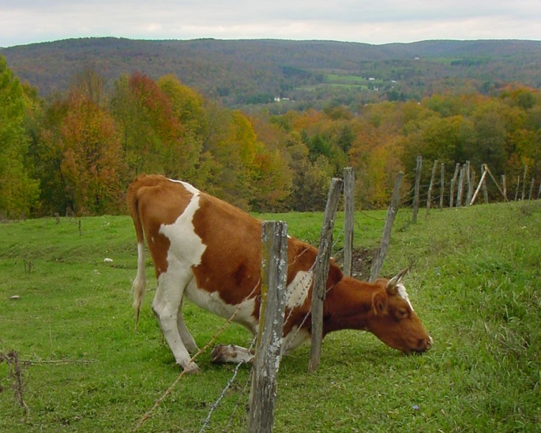
Reactance
“The grass is always greener on the other side.”
Does not being able to have something or do something increase your desire to have it?

Slide 4
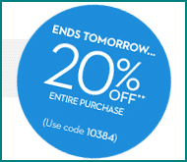
Objectives for today
Define scarcity
Discuss use of scarcity in persuasion
Define psychological reactance
Define what (and who) causes reactance
Discuss how we respond to reactance
Discuss how to reduce reactance in persuasion targets

Slide 5
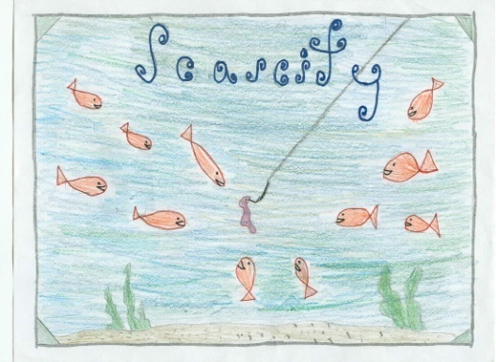
The effect of scarcity
Concerns the perception that if something is rare, it is more valuable.
This is more true about things that are newly scarce.
Big Bang Theory: Aqua Man
We are more motivated by not losing something instead of gaining something of equal value.
There are several ways that the perception of scarcity can be manipulated:
Limited numbers: We want things more if there are fewer of them
Time limits: If something is available for only a short time, it becomes more desirable.
We may also perceive scarcity with information.

Slide 6
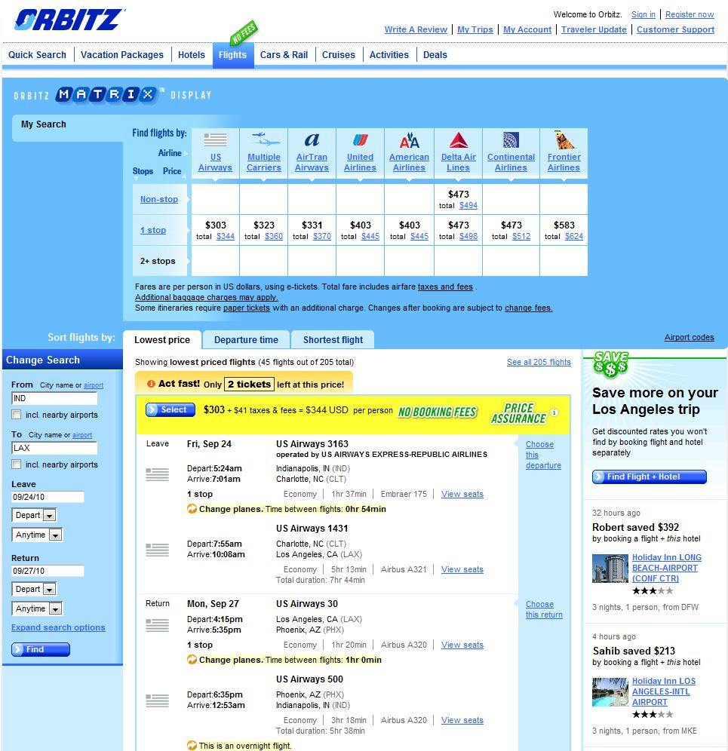

Slide 7
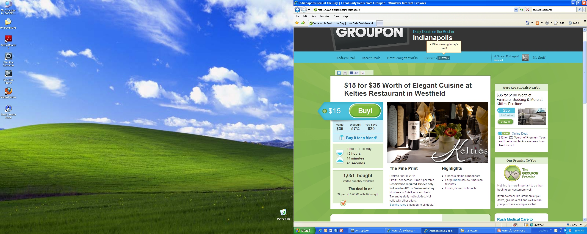

Slide 8
Are diamonds scarce?
*Clip: Diamonds Part 1, Ch. 3
Why do we still value diamonds if they aren’t scarce?

Slide 9
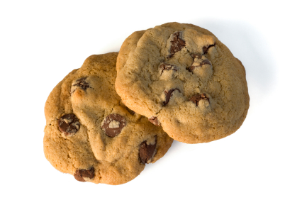
Another example
Worchel, Lee, and Adewold (1975) asked people to rate chocolate chip cookies.
They put 10 cookies in one jar and two of the same cookies in another jar.
The cookies from the two-cookie jar received higher ratings—even though the cookies were exactly the same.
If there were a lot of cookies in a jar, and then a short time later most of the cookies were gone, the cookies that were left received a higher rating than cookies that were in a jar where the number of cookies didn’t change.
Lessons:
We want items that are scarce more than ones that are abundant.
Newly-scarce items are more desirable than items that are already scarce.
We can see the same principle on HSN, booking flights (“Only 2 seats left at this price”), and retail sites (“1 in stock: Order soon!”)

Slide 10

Scarcity, Effort, and Restriction
Scarcity is not just about objects.
Scarcity, effort, and restriction help to shape how we will react to information.

Slide 11

Scarcity and information
Scarcity:
A message increases in effectiveness to the extent that the recipient perceives that few others exist who might have delivered the same message.
A message increases in effectiveness to the extent that receiver perceives that few others will also be receivers of the information.

Slide 12
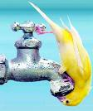
Scarcity, continued.
Effort:
Message increases in effectiveness the more you need to coerce the source to disclose the information.
The greater the perceived effort involved for the communicator to transmit it.
The greater the magnitude of the recipient’s effort to obtain the information or decode it.
Restriction: message increases in effectiveness in proportion to the amount of accompanying reasons opposing the disclosure.
Ex: Edward Snowden and National Security Agency leaks

Slide 13
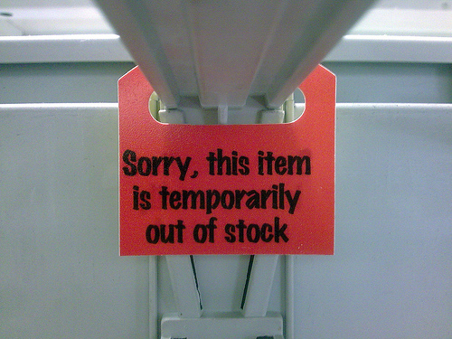
Effect of scarcity: Other examples
Bar closing time: people start to look a lot better
Someone who is involved is more attractive
Collecting antiques
Children’s portrait studios

Slide 14
Reactance

Slide 15
Scarcity vs. Reactance
Diamonds vs. Guns
Trait vs. state reactance

Slide 16
Hong Psychological Reactance Scale (M = 3)
1 = Strongly Disagree, 2 = Disagree, 3 = Neither Agree nor Disagree, 4 = Agree, 5 = Strongly Agree
1. Regulations trigger a sense of resistance in me.
2. I find contradicting others stimulating.
3. When something is prohibited, I usually think, “That’s exactly what I am going to do
4. The thought of being dependent on others aggravates me.
5. I consider advice from others to be an intrusion.
6. I become frustrated when I am unable to make free and independent decisions.
7. It irritates me when someone points out things which are obvious to me.
8. I become angry when my freedom of choice is restricted.
9. Advice and recommendations usually induce me to do just the opposite.
10. I am content only when I am acting of my own free will.
11. I resist the attempts of others to influence me.
12. It makes me angry when another person is held up as a role model for me to follow.
13. When someone forces me to do something, I feel like doing the opposite.
14. It disappoints me to see others submitting to standards and rules.

Slide 17
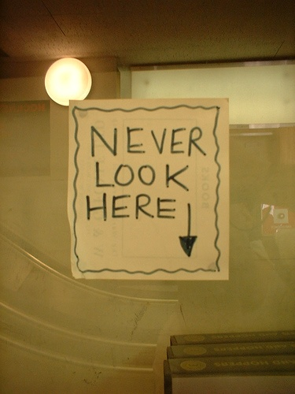
Reactance: Assumptions
People have an intrinsic desire to
behave and think as they wish.
When a person’s freedom of thought or action is threatened, s/he experiences psychological discomfort (a motivational drive) called reactance.
Reactance motivates a person to act to maintain or regain threatened or lost freedom.
In popular discourse, evoking reactance is often termed “reverse psychology.”

Slide 18
Elements in the reactance process
Perceived freedom
Must be able physically and psychologically able to engage in the behavior.
“Freedom” is not an abstraction; it is linked to an actual behavior that matters to a person.
Threat to freedom
Can be a perceived threat (potential for restriction) to what you do, how you do it or when you do it.
Reactance
Restoration of freedom

Slide 19
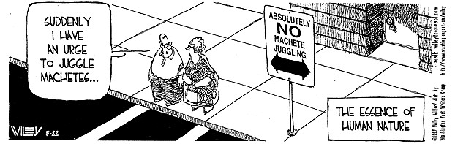
What is a ‘free behavior’?
We are speaking of reactance in terms of specific freedoms, not freedom in general.
Any realistic act that we can engage in presently or in the future.
We have to know that we have this freedom.
We have to know that we are able to carry out the freedom and can carry out the freedom well.
Freedoms can be absolute (i.e., thinking about things) or conditional (i.e., doing your chores before playing outside).

Slide 20
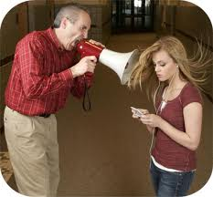
Who takes away our freedoms?
Authority figures
The greater the authority, the higher the reactance if observation is perceived to be low.
Teachers
Police officers
Religious figures
Laws/rules
Prohibition
Friends and family
The Romeo and Juliet effect

Slide 21
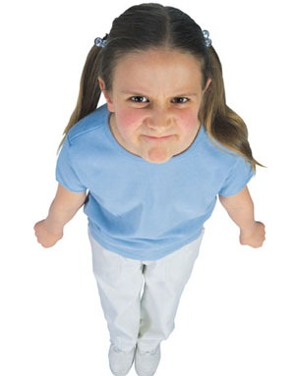
Factors arousing reactance
Person must perceive that they are no longer free to behave or act as they wish on this issue.
The elimination of the behavior must be perceived as illegitimate or unjustified.
The more justified the elimination of the behavior, the less reactance will be experienced.
Phosphate ban

Slide 22
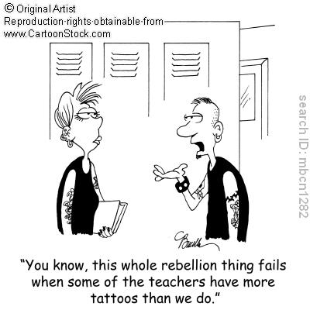
Magnitude of reactance
The magnitude of the arousal depends on the similarities of the alternatives to the restricted behavior.
Reactance is minimal when the alternatives are very similar.
The less important the behavior, the less reactance will be aroused by its elimination.

Slide 23
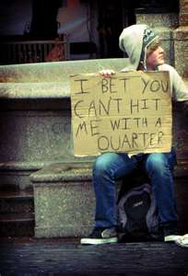
Response to reactance
Reactance is highly motivating-- behaviorally, cognitively, and affectively.
Reactance motivates people to respond by:
Performing the restricted behavior.
Counterarguing the reasons for the restriction and any benefits the restriction might have.
Changing attitudes toward the various alternatives, particularly re-evaluating more favorably the threatened or eliminated alternative.

Slide 24
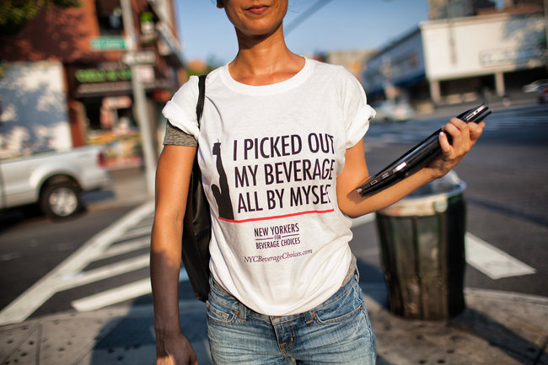
Restoring freedom
We will try to restore the restricted behavior if:
The actions required are realistic.
We anticipate that we will be successful.
The cost of the restoration is low.

Slide 25
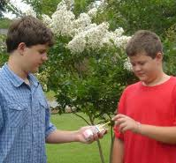
Exceptions to reactance
Importance of freedom is low.
Importance of freedom is low and the power of the persuader is very high.
When there is a greater chance of being caught engaging in the behavior by the social power and being punished.

Slide 26
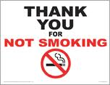
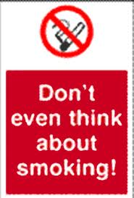
What if we are the ones taking away freedoms?
We may want people to engage in certain behaviors.
These examples have been studied in the context of smoking, littering and graffiti, to name a few.
Which messages are more effective in reducing reactance in the target?

Slide 27

Reactance boosts sales of banned books
In the1920s, publishers actively tried to get Boston’s city council to ban their books, knowing that it would increase sales around the country.
Mark Twain was glad that The Adventures of Huckleberry Finn was banned, because it increased the sales of the book.
Michael Moore gave money to the owner of an anti-Moore website to keep it going.

Slide 28
Take home points
Reactance is the response when our freedom is taken away.
The tactic is used in persuasion to motivate us to engage in a behavior.
However, if the behavior is the opposite of what we want to do, we will fight back.
Messages that are gentler that include the target in the action are more effective.

